Slide 1
Automate Operational Readiness and Validation Testing
of SQL Server with Powershell and Pester

Slide 2

Get-Help –Name ‘about_Presenter’
Mike F Robbins
Microsoft MVP
SAPIEN Technologies MVP
Leader & Co-Founder of Mississippi PowerShell User Group
Co-Author of Windows PowerShell TFM 4th Edition
Author of Chapter 6 in the PowerShell Deep Dives book
Winner of the Advanced Category in the 2013 Scripting Games
Learn more about me @ mikefrobbins.com

Slide 3
Pester
Unit Test Framework for PowerShell
Assertions
Should
Mocking
Isolated File Operations
TestDrive
Unit Testing within Modules
Public Functions
Private Functions
For more info about Pester, see: https://github.com/pester/Pester/wiki

Slide 4
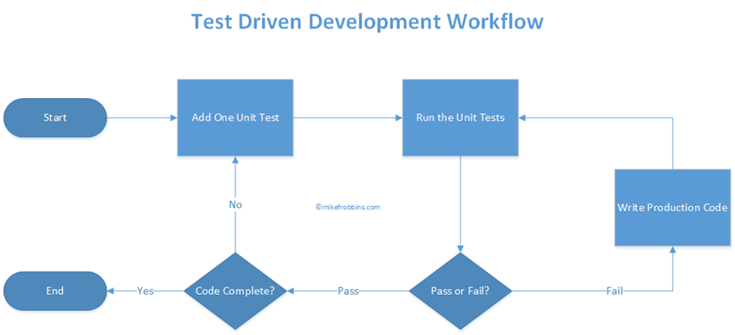
Test-Driven Development (TDD)
Source: http://mikefrobbins.com/2016/05/12/why-isnt-test-driven-development-more-widely-adopted-and-accepted-by-the-powershell-community/

Slide 5
Operational Validation Testing
PowerShell
Pester
TSQL
WMI
Operation Validation Framework
Other third party products

Slide 6

Start-Process ‘Demo’
Demo Code: github.com/mikefrobbins/Presentations

Slide 7
Select-Object –Property ‘Resources’
Pester Wiki on GitHub
Operation Validation Framework
PowerShell.org
PowerShell Magazine
Hey, Scripting Guy! Blog
User Groups
Twitter
Blogs
Slack
Trello

Slide 8



Get-Contact –Identity ‘Presenter’
Blog: mikefrobbins.com (or MrPowerShell.com)
Twitter: @mikefrobbins
LinkedIn: www.linkedin.com/in/mikefrobbins
E-Mail: See mikefrobbins.com/about/
User Group: mspsug.com (or MsPowerShell.com)

